Slide 1

Learning intentions: Today we are learning about beliefs about God and focusing on God the creator.
Success criteria:
By the end of the lesson I will be able to:
. Be clear about the Omni’s.
. Understand the story of creation according to Judaism.
. Know the order of that creation.

Slide 2
Judaism
Beliefs
• beliefs about God
• nature of human beings: yetzer tov; yetzer harah; free will; suffering
• beliefs about Covenant
• judgement; the Messiah; the Messianic Age; Olam Ha’ba
Practices
• living according to the Commandments
• Rosh Hashanah; Yom Kippur
• worship: Shabbat; synagogue

Slide 3
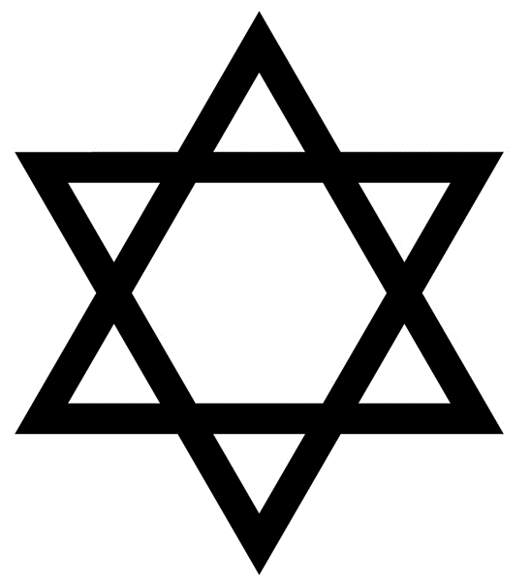

18.6.21 The names of God
In Judaism the following are the most popular characteristics used to describe God.
Omniscient: All Knowing.
Omnipresent: All present.
Omnibenevolent: All loving.
Omnipotent: All powerful.
Eternal: Has always been and will always be.
Just and merciful: Fair but loving.
Key words

Slide 4
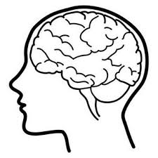
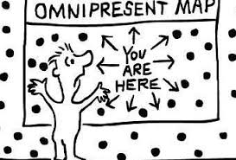
12 minutes
For each of these words create a picture to help you remember it.
It could simply be an object or an emoji or a certain colour or shape.

Slide 5

We have learnt that God has many different characteristics.
He is one as well as all the Omnis, and the characteristics on the sheet.
These reveal two very different and distinct ideas about God which are both considered equally important.

Slide 6


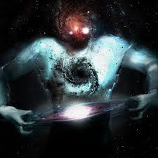
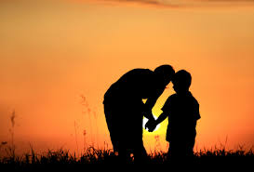
Two distinct ideas about God can be seen:
1. God is an all-powerful being who is quite beyond human ability to understand or imagine.
2. God is right here with us, caring about each individual as a parent does their child.
Judaism seeks to combine these two ideas.

Slide 7


God is an all-powerful being who is quite beyond human ability to understand or imagine. POWER
God is right here with us, caring about each individual as a parent does their child. PRESENCE
Look through the list again and highlight the ideas according to whether they show Gods power or his presence.
Make a key to explain your work
Power Presence

Slide 8
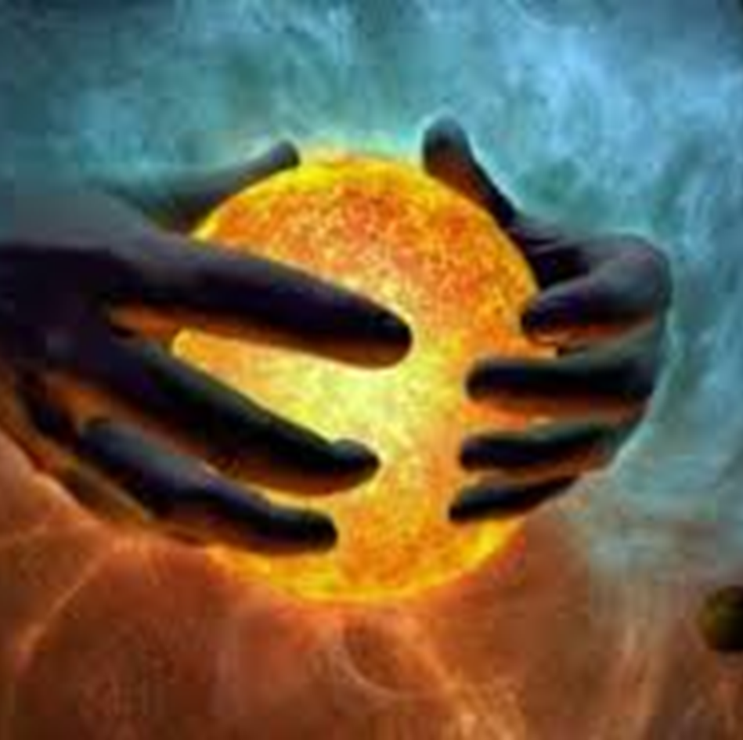
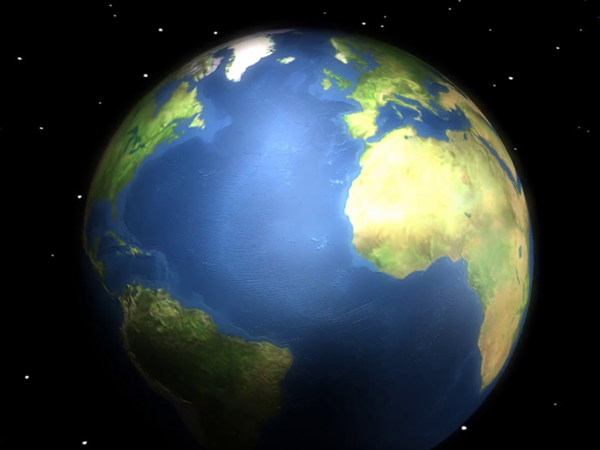
Another key aspect of God’s nature if that he is the creator. So we are going to be learning about the Jewish view on how the world began.
But what do you think?
How did the world begin?

Slide 9

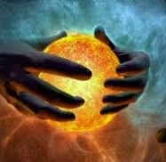
The Jewish perspective: “Creatio ex nihilo” Latin meaning: Creation out of nothing.

Slide 10
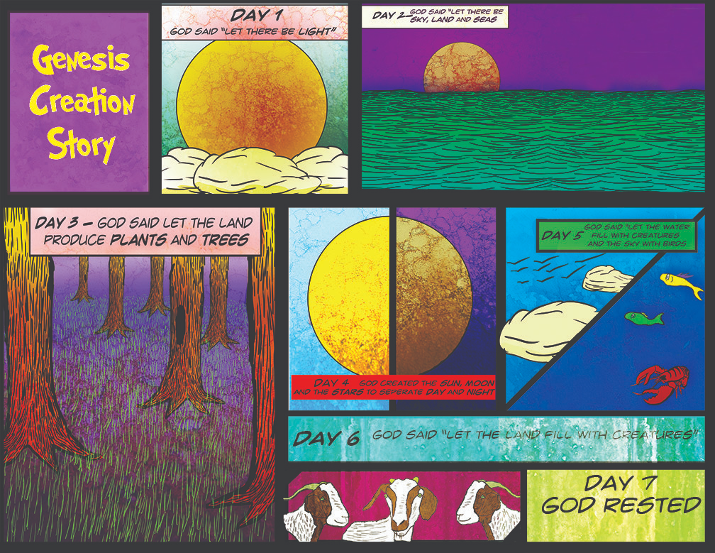
The creation story is the found in the first book of the Torah: Genesis.
Lets read it together.

